Slide 1

Directory Size Calculator
Presented by Diego Bravo
Java Developer Assignment Presentation

Slide 2
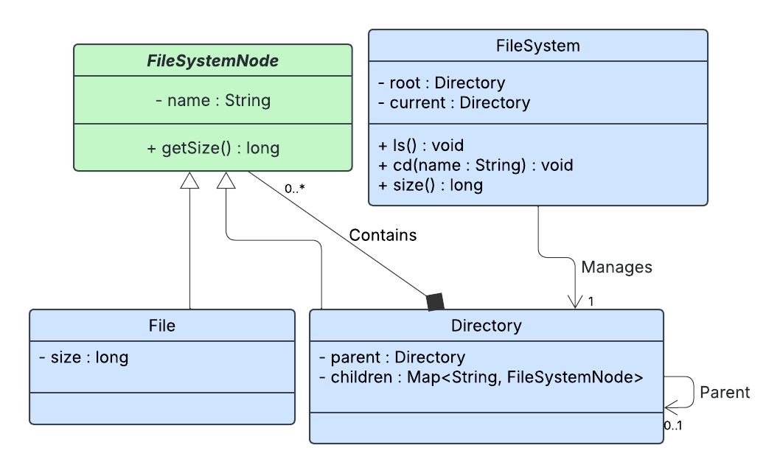
Approach and Design

Slide 3
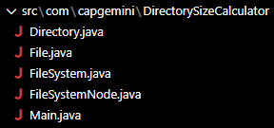
Key Files and Folders
This application backend is composed of 4 classes: FileSystem, FileSystemNode, Directory, and File.
The FileSystem…
  Tracks the root directory
  Tracks the current working directory
  Implements cd, ls, and size
FileSystemNode is an abstract class which…
  Is the common parent for files and directories
  Has a name
  Exposes getSize() (polymorphic)
Directory
  Contains child nodes (files or directories)
  Has a reference to its parent (for cd ..)
  getSize() recursively sums child sizes
File
  Has a fixed size
  getSize() returns its size
Main.java implements the command-line UI and creates a FileSystem object.

Slide 4
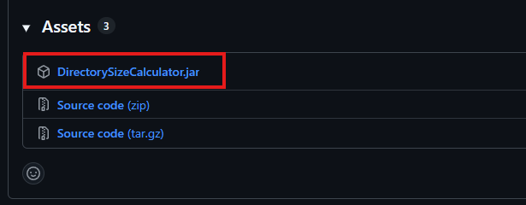
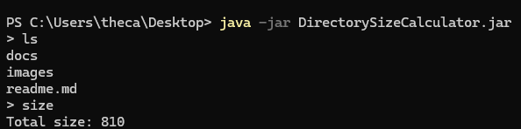
Process to Run, Test, and Verify
Go to GitHub release page.
Download DirectorySizeCalculator.jar.
Open the destination folder in your command line terminal and run java -jar DirectorySizeCalculator.jar
Sample data has already been set up for the demo.
  Use commands: cd, ls, or size
  This program’s version of cd is simple. Only cd <directory_name> or cd .. works. Do not use paths.
  Size at root (total size of all files) is 810. Sizes should be smaller in every other directory.

Slide 5
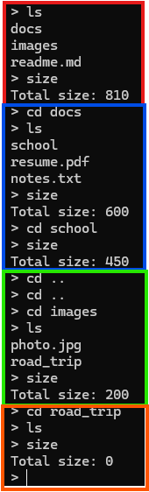
Tests
Nodes at root and total file system size.
Navigating through docs and further directories; calculating size of each.
Navigating back through directories with cd .. and navigating through another directory.
Checking edge cases of an empty directory.

Slide 6
Thank you for tuning in!

